Slide 1
Router
Router connects two completely separate LANs at the network layer forming a single large network with two collision domains. It is more intelligent in selecting the most efficient path towards the destination.
The basic function of a router is to route a packet towards the destination along the best possible path

Slide 2
Layer 2 and Layer 3 Switches
A Layer 2 switch works with MAC addresses only and does not care about IP address or any items of higher layers.
Layer 3 switch, or multilayer switch, can do all the job of a layer 2 switch and additional static routing and dynamic routing as well.

Slide 3
Next Generation Firewalls
A traditional firewall provides stateful inspection of network traffic. It allows or blocks traffic based on state, port, and protocol, and filters traffic based on administrator-defined rules.
A next-generation firewall (NGFW) does this, and so much more. In addition to access control, NGFWs can block modern threats such as advanced malware and application-layer attacks.
IPS solutions help filter out malicious activity before it reaches other security devices or controls. This reduces the manual effort of security teams and allows other security products to perform more efficiently.

Slide 4
Intrusion Prevention System (IPS)
IPS solutions help filter out malicious activity before it reaches other security devices or controls. This reduces the manual effort of security teams and allows other security products to perform more efficiently.
The IPS is placed inline, directly in the flow of network traffic between the source and destination. This is what differentiates IPS from its predecessor, the intrusion detection system (IDS). Conversely, IDS is a passive system that scans traffic and reports back on threats.
Usually sitting right behind the firewall, the solution analyzes all traffic flows that enter the network and takes automated actions when necessary.

Slide 5
Access Points and Controllers
Access points are used to provide connectivity to the users. It connects users to the network quickly and efficiently with some security. An access point is a device that creates a WLAN. It connects to switches and routers and to other network devices.
Cisco provides controllers, i.e., Cisco DNA (Digital Network Architecture). DNA centers simplify network management, lower costs, and incorporate cloud services and third-party integrations. WLC stands for Wireless LAN Controller, which is used to manage many access points. Lightweight access points ask WLC to manage and configure them.

Slide 6
Endpoints and Servers
An endpoint is a network device that communicates with our network to reach resources like data storage and other endpoints. Endpoints interact with users, following specific standard protocols. Endpoints have an OS which interacts with physical hardware using drivers. Example of endpoints: desktop, laptop etc.
A server is also an endpoint which serves the resources on the network. Servers provide resources like websites, files, security software etc. Servers can run various OS like Windows and Unix for different purposes.

Slide 7
3 Tier Architecture
According to Cisco, networks have been divided into layers or tiers for better understanding. The three-tier architecture is one of the oldest and classic networking models.
As the name suggests, the three-tier architecture consists of the following 3 layers:
Access Layer (bottom layer)
Distribution Layer (middle layer)
Core Layer (Topmost layer)

Slide 8
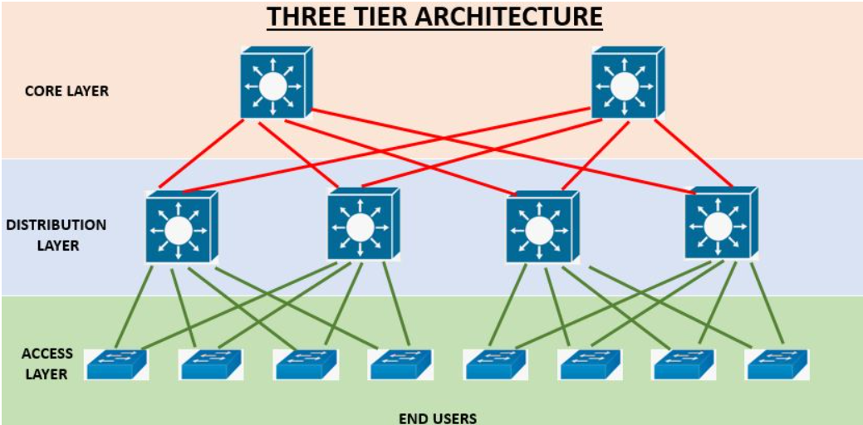
3 Tier Architecture

Slide 9
3 Tier Architecture - Access Layer
The access layer is the lowest layer in the 3-tier architecture.
It is also called as workstation layer.
It is the closest layer to the end users.
It consists of access switches.
These switches connect users to the network.

Slide 10
3 Tier Architecture - Distribution Layer
It is the middle layer in the three-tier architecture.
The distribution layer is also, sometimes, referred to as the aggregation layer.
It performs quality of service and security work.
It consists of multilayer switches.
It moves the traffic from the access layer to the core layer.

Slide 11
3 Tier Architecture – Core Layer
It is the topmost layer in the three-tier architecture.
The Core layer also has another name which is the backbone layer.
It connects distribution layer devices.
It performs high-speed transport of traffic.

Slide 12
2 Tier Architecture
2 Tier Architecture is also called Two-Layered Hierarchical Model or Collapsed Core Model. This architecture is used by small enterprises that can not use 3 Tier architecture. Because, 3 Tier Architecture is a good solution but also an expensive solution.
There are two layers in this architecture. These are :
Collapsed Core Layer
Access Layer
Collapsed Core Layer provides both Core and Distribution Layer duties. Distribution policies are used in this layer.

Slide 13
Spine Leaf Architecture
With the new requirements to become more scalable, fast and efficient, a new datacenter design is developed. This design is replaced with three tier design that is used mostly in networking World.
Spine Leaf Architecture is the network architecture with which all the devices are the same segments away. It is the two layered architecture consist of Spine Layer and Leaf Layer.
The Leaf Layer is the layer, consist of Access devices, switches, servers, edge routers etc. The Spine Layer is the core layer of Spine Leaf Architecture. Routing is the first duty of Spine layer. In Spine Leaf Architecture Design, every Leaf switch is connected to all the Spine Switches.

Slide 14
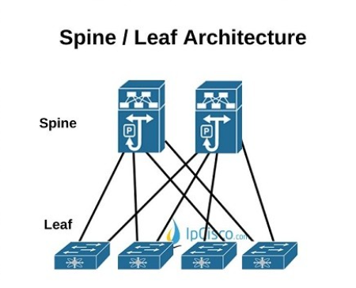
Spine Leaf Architecture

Slide 15
Small Office/Home Office (SOHO)
The SOHO architecture consists of the simplest architecture.
As the name suggests, it is mostly used in homes and/or small enterprises.
This type of architecture consists of three components:
A small switch
A router
Connected access devices such as printers, PCs, etc.
Usually, a single device is used that acts as both a switch and router.
The devices are hardwired into this router.
This router also acts as a firewall.

Slide 16
On-Premises and Cloud
SaaS:
Cloud architecture is more of an as-a-service model than a network topology. For example, if you’re using Google Docs on the cloud, you’re not aware of its network topology. This refers to as Software-as-a-Service.
PaaS:
If you’re working with Platform-as-a-Service (PaaS), you might be familiar with the cloud topology. You can access any development resource using PaaS such as Operating Systems to test out any application.
IaaS:
When you’re setting up a cloud-based network topology, you’re using Infrastructure-as-a-Service (IaaS). Networks, servers, and firewalls are organized in the topology as virtualized components.

Slide 17
Single Mode, Multi Mode
Single-mode fiber-optic cable allows only one mode (or wavelength) of light to propagate through the fiber. This type of cable is capable of higher band-width and greater distances than multimode and is often used for campus backbones. Single-mode cable uses lasers as the light-generating method and is more expensive than multimode cable. The maximum cable length of single-mode cable is 60+ km (37+ miles).
Multimode fiber-optic cable allows multiple modes of light to propagate through the fiber. Multimode cable is often used for workgroup applications, using Light Emitting Diodes (LEDs) as light-generating devices. The maximum length of multimode cable is 2 km (1.2 miles).

Slide 18
Ethernet – Shared Media and Point to Point
Shared Media
All computers connected to a shared broadcast-based communication channel and share the channel bandwidth. Security issues as a result of broadcasting to all computers.
Cost effective due to reduced number of channels and interface hardware components.
Point to Point
Computers connected by communication channels that each connect Exactly two computers with access to full channel bandwidth. Forms a mesh or point-to-point network.
Allows flexibility in communication hardware, packet formats, etc.
Provides security and privacy because communication channel is not shared.

Slide 19
Power over Ethernet (PoE)
Power over Ethernet (PoE) is a technology that transmits both electrical power and network data over an ethernet cable. With PoE, each Ethernet interface of LAN switches can supply power to devices like VoIP phones, IP cameras or security cameras, and wireless access points (AP).

Slide 20
TCP
It stands for Transmission Control Protocol.
It is a connection-oriented protocol, which means that the connection needs to be established before the data is transmitted over the network.
TCP is slower than UDP as it performs error checking, flow control, and provides assurance for the delivery of Data Packets.

Slide 21
UDP
It stands for User Datagram Protocol.
It is a connectionless protocol, which means that it sends the data without checking whether the system is ready to receive or not.
UDP is faster than TCP as it does not guarantee the delivery of data packets.

